Slide 1




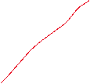

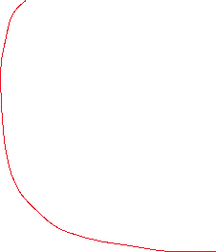
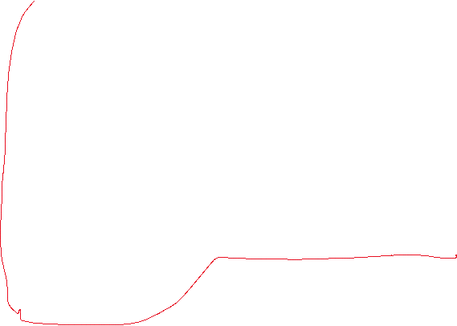


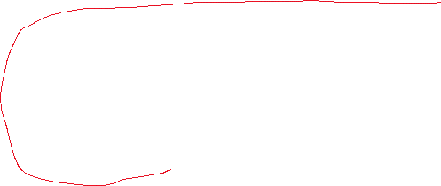




Too strong? “can be unrealistic”
References?
Define demand as amount of people?
Too strong?
Let’s first focus on a single period model, because it is simpler. In other words, skip this.
The impacts of demand and forecast uncertainty can likely be shown with a single period model.
Use consistent terminology. Demand?
Find references for these. I.e., avoid “inventing” reasons by yourself.
Use consistent terminology. True?
Skip? Focus on one period. Just large demand?
Has? In general, it is best to avoid “human” verbs, especially sensory
Befitting?
Reference?
Shorten and merge with previous paragraph? I would envision that the merged paragraph would be the motivation for the modeling of D ~ lognormal (as a formula).
Find references for these. I.e., avoid “inventing” reasons by yourself.
Motivate forecast uncertainty with the fact that experts and demand models are unlikely to be exact.
Also motivate why the DM needs experts.
I envision that this paragraph would be the motivation for lognormal forecast (formula).
Skip? Unlikely that we will be considering this in the model
Use this paragraph to motivate why the decision maker will base his capacity investment decisions on the estimates.
Focus on single period?
Shorten and merge with previous? Motivate more why balancing is required (e.g., other disasters events are possible). The merged paragraph would be the motivation for the cost formulas.
Furthermore motivate (e.g., for the sake of transparency) why we we should probably focus on the minimization of expected costs (i.e., disregard stuff like risk aversion etc. for now).
Avoid “guesses” about what the result will be.
7. Evaluation of performance after event is over…. Compare against true demand vs estimates…

